Slide 1

Project 4
Human Emotion Recognition
Parvez Alam
Kaushal Patel
Wilfred Andoh
Frank McKenzie-Stripp

Slide 2

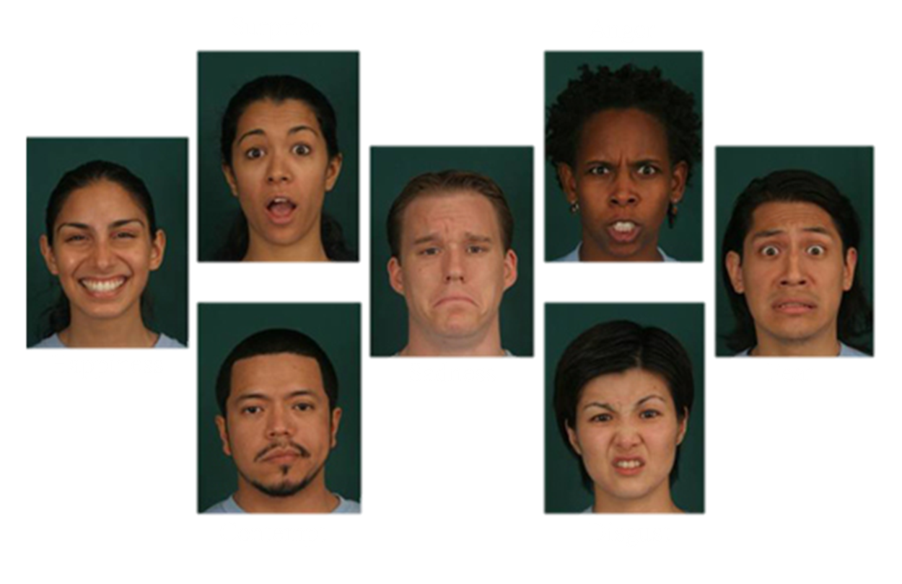
Introduction
Emotion recognition is the field of identifying distinct human emotions - usually through facial expressions.
Humans are innately skilled at this, but even we struggle sometimes.
Goal: Create a machine learning model capable of classifying a person’s emotion based on their facial expression.

Slide 3


Overview
Data Collection
ETL Process
Train the Model
Test the Model

Slide 4
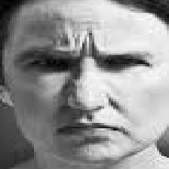






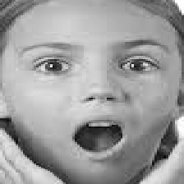
Dataset
Consists of 27,000 48×48 grayscale images of faces, categorized by facial expression into seven categories:
Anger, disgust, fear, happiness, neutrality, sadness, and surprise.
Sources:
https://www.kaggle.com/datasets/sudarshanvaidya/random-images-for-face-emotion-recognition
https://www.kaggle.com/datasets/jonathanoheix/face-expression-recognition-dataset

Slide 5


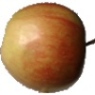
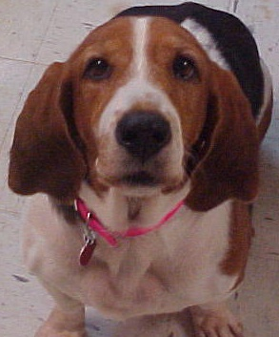


Human Face Recognition
An additional model for determining if a face is human or not.
Dataset is made up of images divided into “human_face” and “others”.
Source:
https://www.kaggle.com/datasets/prasunroy/natural-images

Slide 6
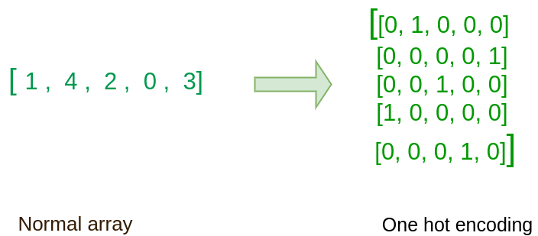
Preprocessing
To prepare the dataset for use:
Image files were programmatically renamed.
E.g. Anger images renamed as: “an_0”, “an_1”, “an_2”, etc.
Resize and convert images to grayscale.
Created a function for converting images to NumPy arrays.
Split the datasets into two, for training and testing.
Scaled the data using MinMaxScaler()
One-Hot encoded data using the Keras to_categorical() function.
Normal Array
One-Hot encoded

Slide 7
CNN
What is a CNN?
A class of deep learning neural networks.
In a CNN, every image is represented in the form of an array of pixel values.
CNN can take in an input image, assign importance (learnable weights and biases) to various aspects/objects in the image, and be able to differentiate one from the other.
How it works:
The input layer which is a grayscale image.
The output layer which is a binary or multi-class labels.
Hidden layers consisting of convolution layers with ReLU (rectified linear unit)/ swish activation, batch normalization layer, pooling layers, and a fully connected Neural Network.

Slide 8
CNN
A CNN architecture primarily involves three types of layers:
Convolutional layer
model.add(Conv2D(32, (3, 3), activation='relu', input_shape=(48, 48, 1)))
The model uses 32 filters stacked one after the other and each filter has the dimension 3x3. Thus, the model will learn 3x3x32 i.e total of 288 parameters.
Pooling Layer
model.add(MaxPooling2D((2, 2)))
Here the layer reduces the input image by half in width and height.
Fully connected layer
model.add(Dense(7, activation='softmax'))
Our model will have the above layer at the end, corresponding to 7 categories.

Slide 9
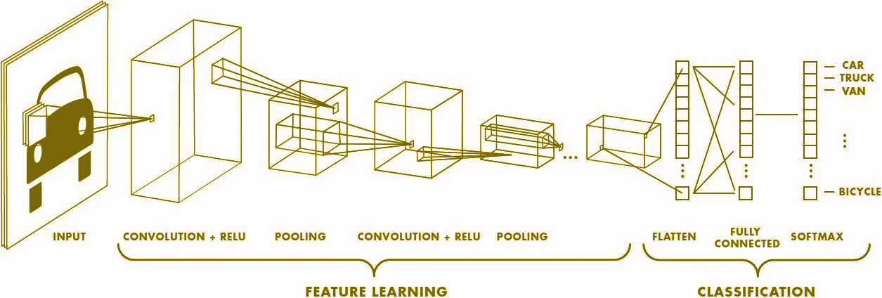
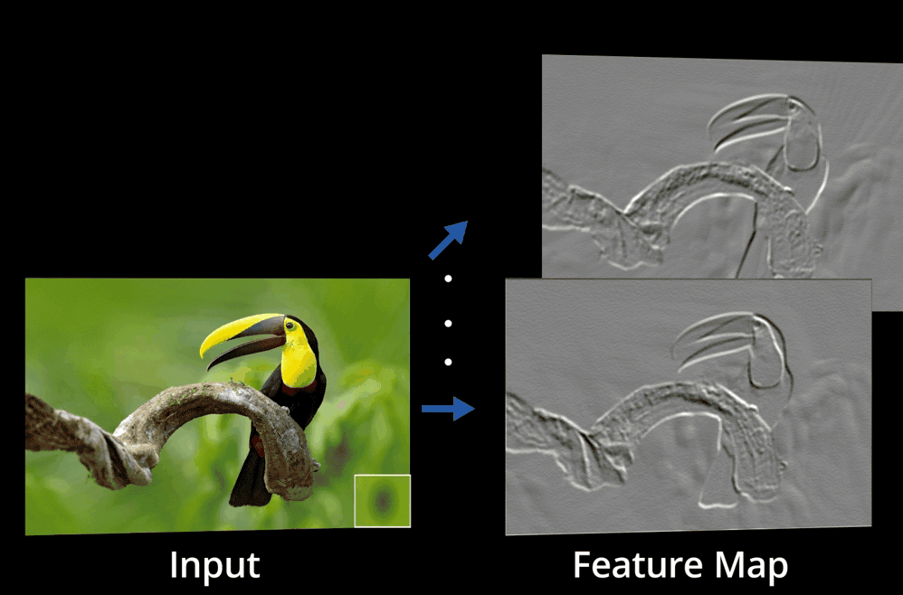
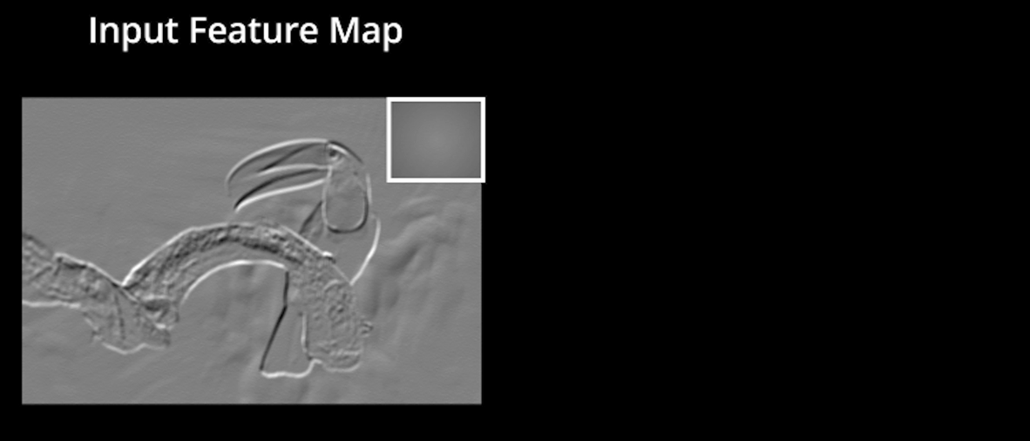
CNN

Slide 10

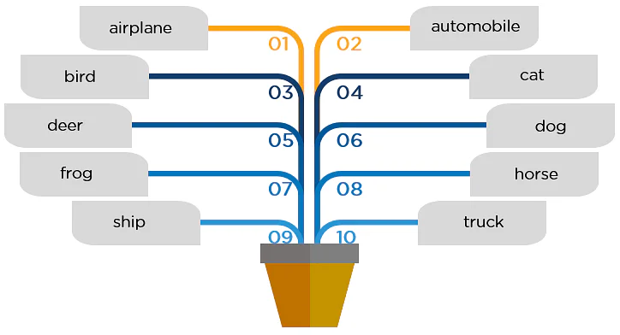

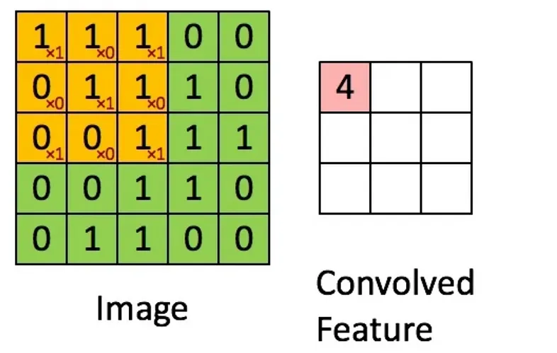
CNN
Kernel 3x3

Slide 11
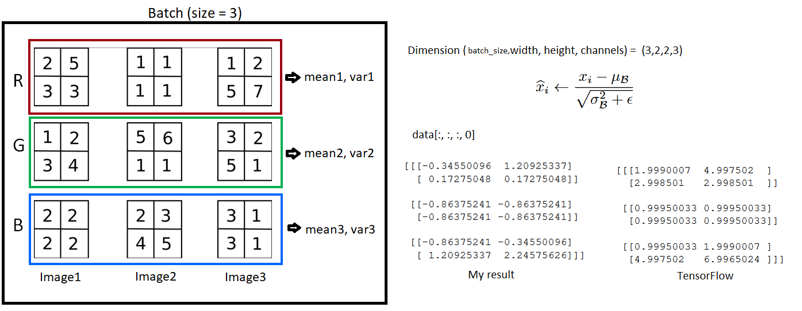
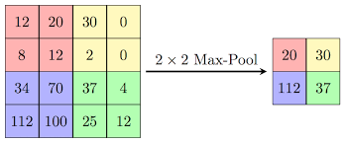
CNN
Batch Normalization
Max Pool

Slide 12
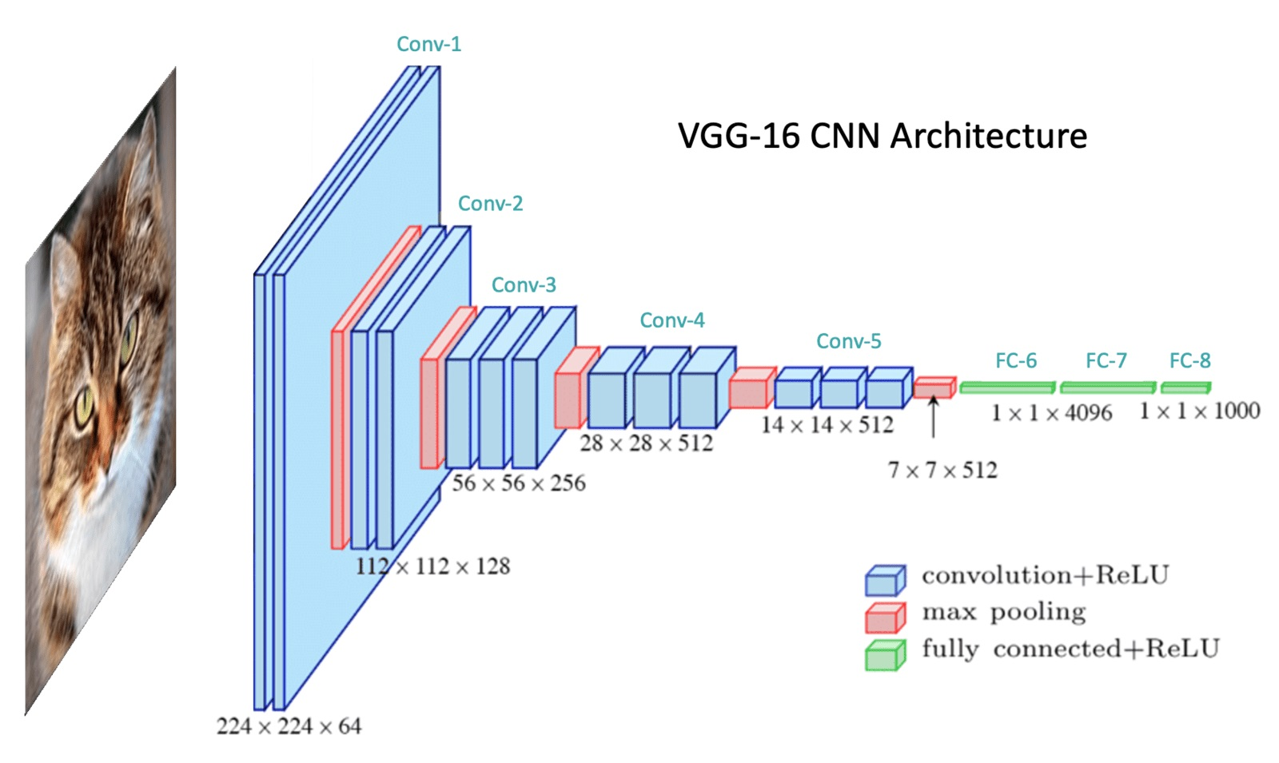
CNN
Example of a CNN Model:
acc@1 (on ImageNet-1K) 71.592
acc@5 (on ImageNet-1K) 90.382
Source: https://pytorch.org/vision/main/models/generated/torchvision.models.vgg16.html

Slide 13
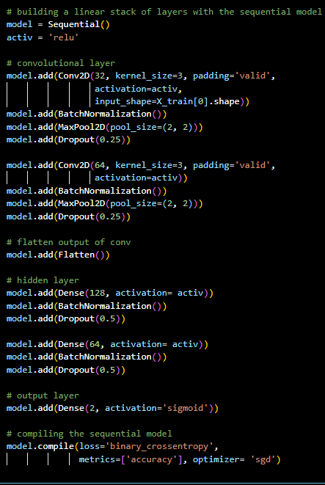
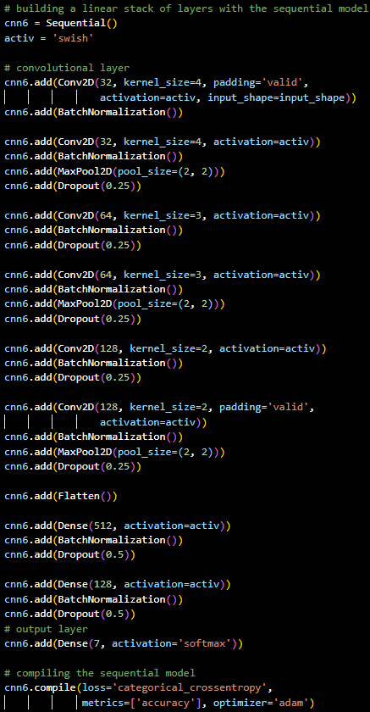
CNN
Face Model Architecture
Emotion Model Architecture

Slide 14
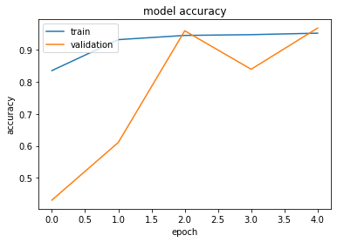
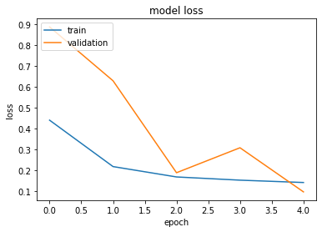
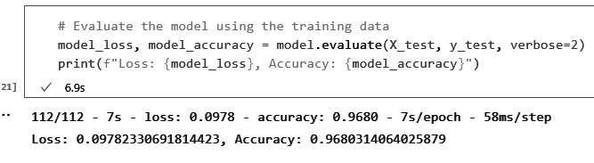
Performance
Face Model

Slide 15
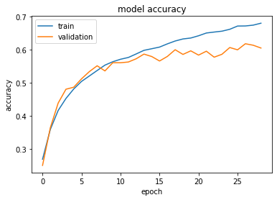
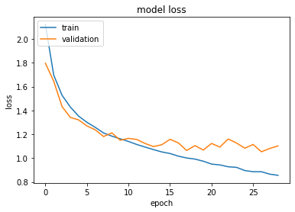
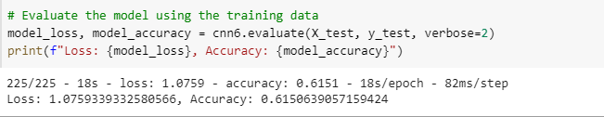
Performance
Emotion Model

Slide 16
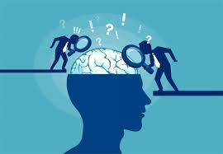
Model Evaluation
Input Limitation:
Our models are trained with images of human face only.
Demonstration:

Slide 17
Conclusion
Emotion recognition is a challenging field, due to the diversity in how people express themselves
Human Face Recognition validation accuracy >90%
Emotion Recognition validation accuracy Top1 >60%, Top3 > 88%
Overall, human face recognition was extremely successful
Emotion recognition is still a work in progress
Limitations:
Time
Relatively low processing power
With more time and resources, model accuracy could continue to be further improved
Notes:
While emotions are universal, we human express our emotions differently depending on the information we receive and how we connote and denote information. These expressions are different taking into consideration our diversity or dynamism.

Slide 18
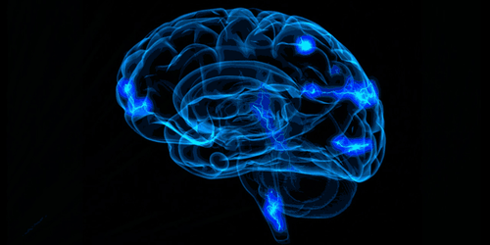
Thanks for listening!
Q&A

Slide 19
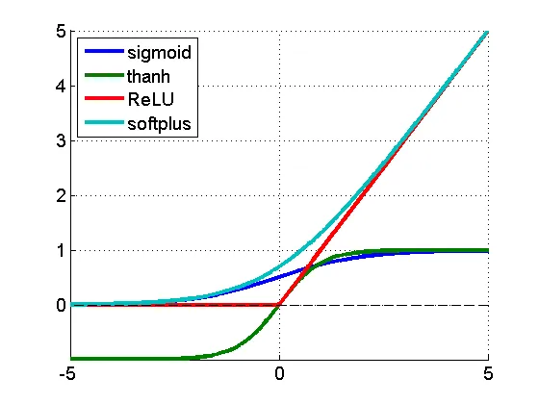
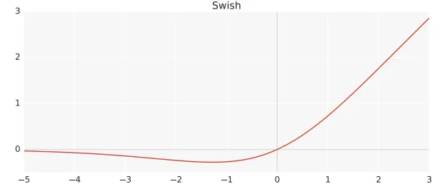
Activation function

Slide 20
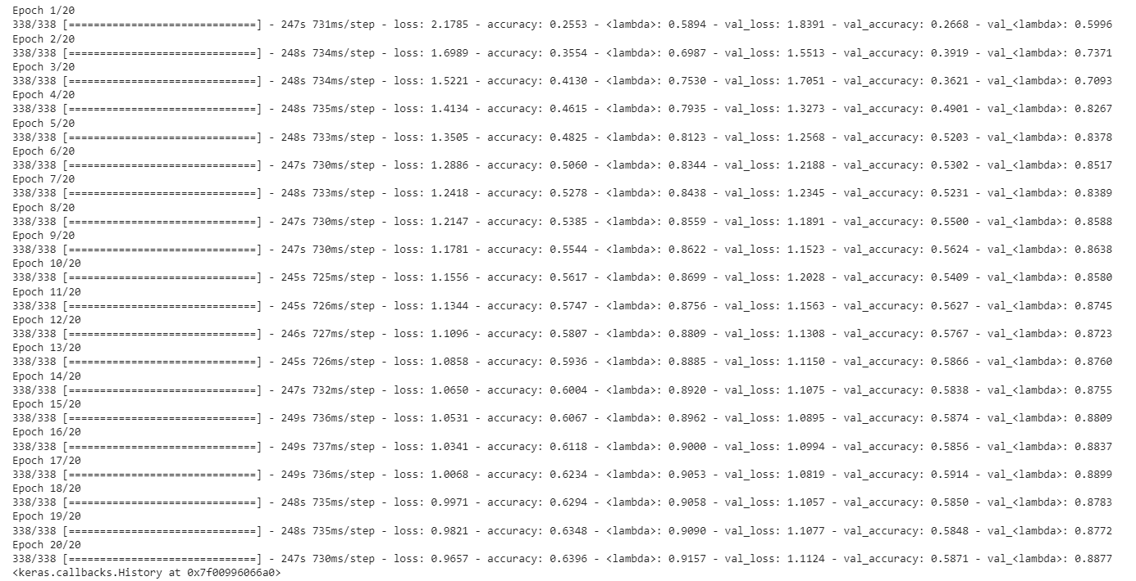
Top 3 categorical accuracy of emotion model

